Slide 1
Research Networking Systems Implementation Survey
Layne M. Johnson (University of Minnesota)
Jihad Obeid (MUSC)
Dave Eichmann (University of Iowa)
Sarah Stallings (C4)
CTSA Research Networking Affinity Group
February 11, 2013

Slide 2
Outline
Introduction
RNS Adoption
Variety of Systems
Linked Open Data – data sharing model
Information Sources
Problems being addressed
Future steps

Slide 3
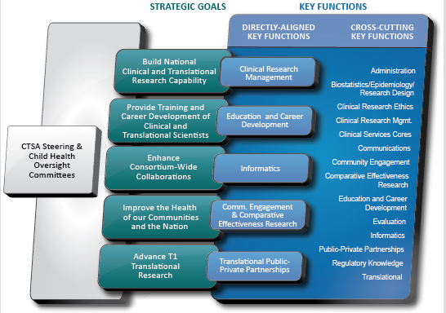

Slide 4
Research Networking Tools
Serve as knowledge management systems for the research enterprise through creation of expertise profiles for faculty, investigators, scholars, clinicians, research assets, facilities, and more.

Slide 5
Rationale for Research Networking Tools
Investigators:
ID potential collaborators, mentors, experts
Form teams
ID Grants
Publicly available bios
Administrators:
Institutional Business Intelligence
Performance reviews
Recruiting
Evaluators:
Analyze networks to improve research effectiveness

Slide 6
Rationale for Research Networking Tools
Other opportunities:
Team building approaches
Data for comparative institutional analyses
Availability of national networks (VIVOsearch, DIRECT2Experts, SciVal)
Support community-engaged research
Public relations

Slide 7
Linked Open Data
Enhances sharing
Allows the creation of national networks
Ontologies provide context and meaning to data
Connectivity potential with other data (e.g. CTSAconnect, eagle-i)

Slide 8
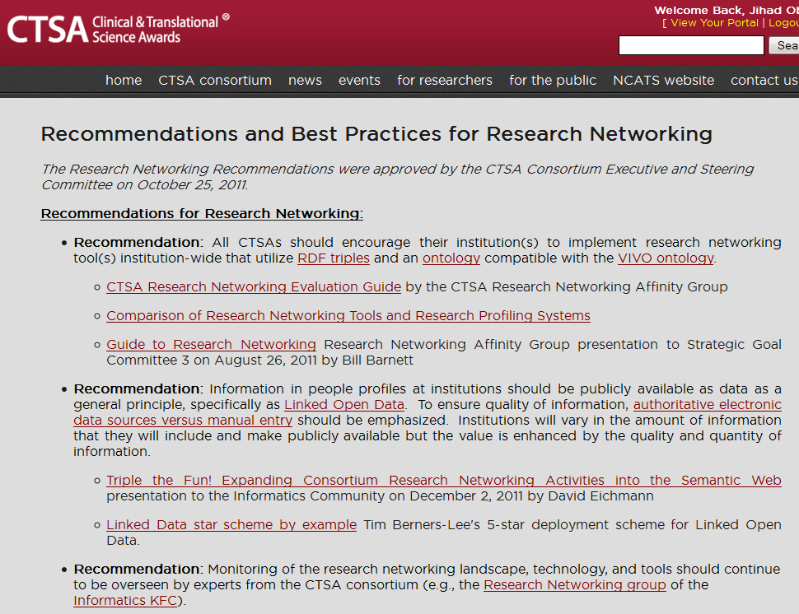
adopt
share
survey
https://www.ctsacentral.org/bestpractices/researchnetworking

Slide 9
Research Networking Affinity Group (RNAG)
Promote and facilitate deployment across CTSA consortium
Promote the used of Linked Open Data
Gather and disseminate information about RNS
Survey level of implementation
ID contacts at each CTSA institution
REDCap survey development facilitated by C4
Notes:
Dave Eichman, Griffin Weber
Jihad Obeid, Sarah Stallings, me, Kristi

Slide 10
Response Rate of 61 Institutions
3 of the 47 have more than one system (more are planning >1)
Some have partial responses

Slide 11
Diversity of Systems (n=51 implementations)
*"Other" includes:
Loki (Iowa)
InfoEd GENIUS (UAB)
Digital Vita (U Pitt)
Knode (Vanderbilt)
Pivot (Indiana)
+ other custom…

Slide 12
Linked Open Data (n=47 institutions)

Slide 13
77,500 out of 167,000 (47%) profiles exist in LOD from 10 sites
Notes:
Although a large number of are currently exposed using LOD, the amount of information coded varies significantly by site (as per Dave Eichmann).

Slide 14
Linked Open Data Projections
Survey data indicate that least 72% of profiles (118,000 out of 167,000) will be in LOD format, searchable as SPARQL endpoints
LOD from 26 sites
(data are most likely under represented – University of Minnesota is case in point)

Slide 15
Data included in RNS (n= 51 implementations)

Slide 16
RNS integrated with Tenure & Promotion Process? (n=47 institutions)

Slide 17
Data indicate SGC3 recommendations had an impact
Influenced developers, vendors, local leadership
More systems adopting/adopted LOD (Profiles, Loki, SciVal experts)
Vendors paying attention (adding functionality, interoperability, etc.)
More activity (at institutions – projected in 6 mo – 2 yrs, conferences – VIVO, AMIA, other)
Notes:
On tools: e.g. profiles xml remodeled for LOD, SciVal interoperable with LOD
One the rare opportunities where there was a consortium wide recommendation (at this level).
Examples of vendors: Scival experts from elsevier

Slide 18
The consortium is doing well in implementing RN to facilitate collaboration
Over time, data suggest:
More adoption
Full data sharing
Resource sharing (e.g. eagle-i, CTSAconnect, C4 cataloging project)
More tools (team science tools, OpenSocial, etc.)
Evaluation of RN impact will become easier as more data become available

Slide 19
We are well into the first generation of research networking tools, but we are still conceptualizing
What “success” means
What successive generations might look like.
What an appropriate search architecture needs to look like

Slide 20
Where Next for RNAG?
We’ve been charged by SGC-3 with the development of an assessment framework for research networking
Aid institutions in comprehending the many process paths to achieving the recommendations
UCSF spearheading affinity group effort to study utilization
Eventually we will address evaluation and impact
Notes:
Many paths… institutional specific drivers
Multiple platforms – the choice of RDF provides the commonality
Adoption rates will naturally vary institution to institution

Slide 21
Where Next for RNAG?
Move into the next generation of search functionality by federating search results from VIVO ontology-based RN systems
Capitalize on the value of these data by building tools that consume them
Identify CTSA-connected research / investigators
Develop Consortium-wide collaboration graphs to illustrate impact of the program as a whole

Slide 22
A Strawperson Success Measurement Framework
Adoption
Who’s running what?
Compliance with recommendations
Nature of data sources
Utilization
Usage tracking at the institutional level
Concept coverage
“Team Science”-class outcomes
Collaborations, grants & papers

Slide 23
A Strawperson Success Measurement Framework
Federation
Ability to search across
Institutions
Systems
Interoperation
Data integration at the consortium level
RDF triples involving URIs from multiple institutions

Slide 24
Where Next?
For the Affinity Group
Aid institutions in comprehending the many process paths to achieving the recommendations
Aid institutions in assessing the multiple options both open source and commercial for research networking systems
Notes:
Many paths… institutional specific drivers
Multiple platforms – the choice of RDF provides the commonality
Adoption rates will naturally vary institution to institution

Slide 25
Where Next?
For the Affinity Group
Move into the next generation of federating search across the available systems using the VIVO ontology
This will likely occur at the grass roots as individual sites begin to innovate
The open nature of LOD is a critical enabler of this innovation

Slide 26
Where Next?
For the Consortium as a Whole
Seize the opportunity to begin to capitalize on the value of these data by building tools that consume them
Identify CTSA-connected research / investigators and the ICs funding them
Develop Consortium-wide collaboration graphs to illustrate impact of the program as a whole

